Slide 1
INPUT/OUTPUT ORGANIZATION
Unit 4
Notes:
44

Slide 2
Accessing I/O Devices

Slide 3
Accessing I/O devices
Processor
Memory
Bus
I/O device 1
I/O device n
Multiple I/O devices may be connected to the processor and the memory via a single bus.
Bus consists of three sets of lines to carry address, data and control signals.
Each I/O device is assigned an unique address.
To access an I/O device, the processor places the address on the address lines.
The device recognizes the address, and responds to the control signals.

Slide 4
Accessing I/O devices (contd..)
Address lines
Bus
Data lines
Control lines
Address
Control
Data and
I/O
decoder
circuits
status registers
int
erface
Input device
I/O device is connected to the bus using an I/O interface circuit which has:
- Address decoder, control circuit, and data and status registers.
Address decoder decodes the address placed on the address lines thus enabling the device to recognize its address.
Data register holds the data being transferred to or from the processor.
Status register holds information necessary for the operation of the I/O device.
Data and status registers are connected to the data lines, and have unique addresses.
Control circuit coordinates I/O transfers.

Slide 5
Accessing I/O devices
I/O devices can be interfaced into computer system in two ways:
Memory-Mapped Input/output
I/O Mapped Input/output.
Memory mapped I/O: here there is a single address space for memory location and IO devices.
The processor treats the status and data registers of IO modules as memory locations and uses the same machine instructions.
For memory mapped IO only a single READ and single WRITE line is needed for memory or IO module Read and Write operations.

Slide 6
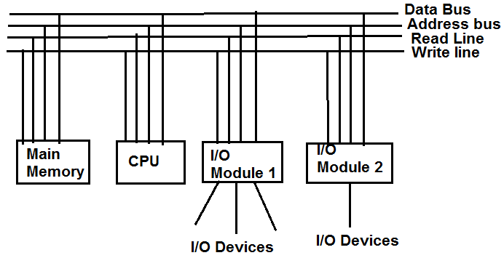
Memory-Mapped IO…

Slide 7
I/O Mapped Input/Output:
With memory mapped IO, a single Read line & a single Write lines are needed on the bus. Alternatively, the bus may be equipped with memory read and write plus input and output command lines.
Command line specify whether the address refers to a memory location or an I/O device.
In IO mapped IO, the IO devices and memory are addressed separately.
There are separate control lines for memory and IO device read or write operations. Thus a memory reference instructions do not affect an IO device.

Slide 8
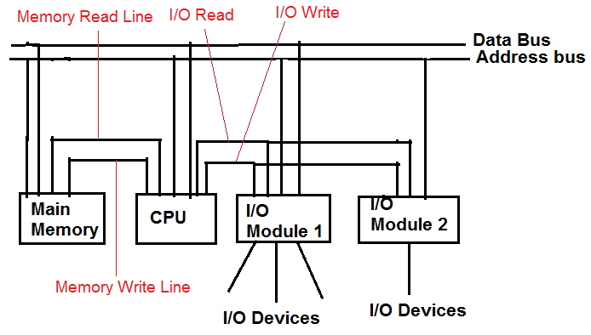

Slide 9
Mode of data transfer
In a computer , data transfer takes place between two devices such as
  CPU & Memory
  CPU & IO devices,
  Memory & IO devices
Modes of data transfer in peripherals: the extent to which CPU is involved, there are 3 techniques for IO operations.
Programmed IO
Interrupt Driven IO
Direct Memory Access (DMA)

Slide 10
Programmed IO: In this technique, IO operation is completely controlled by CPU. i.e., CPU executes programs that initiate, direct & terminate the IO operations.
Interrupt Driven IO: in this technique, CPU initiates the operation and continues to execute other instructions. When IO operation is completed, CPU will be interrupted by IO module and then CPU terminates the IO operation.
Direct Memory Access: in this technique, IO operation and main memory exchange data directly without CPU involvement.

Slide 11
Direct Memory Access

Slide 12
Direct Memory Access (DMA)
The programmed I/O and Interrupt driven I/O requires the involvement of CPU to perform IO operation.
Thus both of these technique suffer from two drawbacks:
The IO transfer rate is limited by the speed in which CPU can test and service a device.
The CPU is tied up in managing an IO transfer. A number of instruction must be executed in that time.
Thus the more efficient technique to overcome the above drawback is Direct Memory Access.
In order to handle the IO devices with higher speed of operation a suitable scheme, which exchange the data directly between the memory & IO deices, DMA is used.

Slide 13
DMA…
During DMA transfer, the CPU is idle and has no control of memory buses.
A separate controller handles the data transfer operation called the DMA controller, takes over the buses.
DMA Transfer:
Some times it is necessary to allow IO exchange to occur directly with memory.
Then the processor grants authority to IO module to read from or write into memory, so that memory transfer can occur without disturbing processor.
During such a transfer, IO module issues Read or Write commands to memory

Slide 14
Direct Memory Access (contd..)
Direct Memory Access (DMA):
  A special control unit may be provided to transfer a block of data directly between an I/O device and the main memory, without continuous intervention by the processor.
Control unit which performs these transfers is a part of the I/O device’s interface circuit. This control unit is called as a DMA controller.
DMA controller performs functions that would be normally carried out by the processor:
  For each word, it provides the memory address and all the control signals.
  To transfer a block of data, it increments the memory addresses and keeps track of the number of transfers.
Notes:
This alternative approach is called as direct memory access. DMA consists of a special control unit which is provided to transfer a block of data directly between an I/O device and the main memory without continuous intervention by the processor.
A control unit which performs these transfers without the intervention of the processor is a part of the I/O device’s interface circuit, and this controller is called as the DMA controller.
DMA controller performs functions that would be normally be performed by the processor. The processor will have to provide a memory address and all the control signals. So, the DMA controller will also provide with the memory address where the data is going to be stored along with the necessary control signals. When a block of data needs to be transferred, the DMA controller will also have to increment the memory addresses and keep track of the number of words that have been transferred.

Slide 15
Direct Memory Access (contd..)
DMA controller can transfer a block of data from an external device to the memory, without any intervention from the processor.
  However, the operation of the DMA controller must be under the control of a program executed by the processor. That is, the processor must initiate the DMA transfer.
To initiate the DMA transfer, the processor informs the DMA controller of:
  Starting address,
  Number of words in the block.
  Direction of transfer (I/O device to the memory, or memory to the I/O device).
Once the DMA controller completes the DMA transfer, it informs the processor by raising an interrupt signal.
Notes:
Repeat DMA controller.
DMA controller can be used to transfer a block of data from an external device to the processor, without requiring any help from the processor. As a result the processor is free to execute other programs. However, the DMA controller should perform the task of transferring data to or from an I/O device for a program that is being executed by a processor. That is, the DMA controller does not and should not have the capability to determine when a data transfer operation should take place. The processor must initiate DMA transfer of data, when it is indicated or required by the program that is being executed by the processor.
When the processor determines that the program that is being executed requires a DMA transfer, it informs the DMA controller which sits in the interface circuit of the device of three things, namely, the starting address of the memory location, the number of words that needs to be transferred, and the direction of transfer that is, whether the data needs to be transferred from the I/O device to the memory or from the memory to the I/O device.
After initiating the DMA transfer, the processor suspends the program that initiated the transfer, and continues with the execution of some other program. The program whose execution is suspended is said to be in the blocked state.

Slide 16
DMA Procedure
Procedure Overview:
Processor sends the starting address, the number of data, and the direction of transfer to DMA controller.
Processor suspends the application program requesting DMA, starts DMA transfer, and starts another program.
After the DMA transfer is done, DMA controller sends an interrupt signal to the processor.
The processor puts the suspended program in the Runnable state.

Slide 17
DMA procedure…
1. When CPU wishes to read or write a block of data from memory, it issues a command to the DMA module by sending the following information using Register Select (RS) and DMA Select (DS) inputs.
The starting address of the memory block from where the operation is to be done, is loaded into the address register.
The number of words to be transferred is loaded into count register.
The mode of transfer such as read or write is specified in the control register.
The address of the IO device which is involved in the data are transfer.

Slide 18
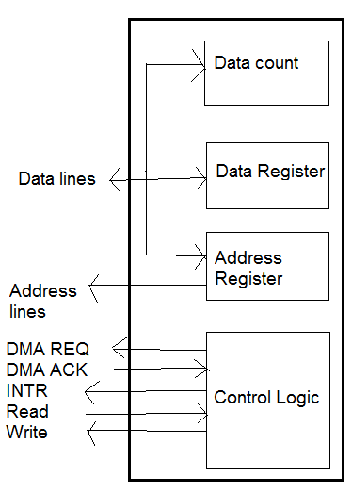
Typical DMA block diagram is as shown

Slide 19
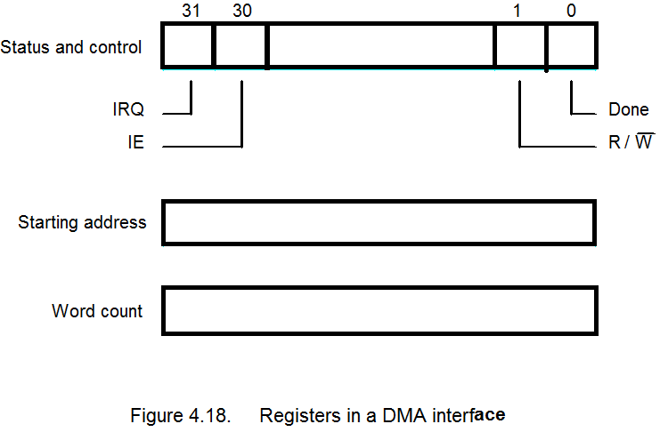
DMA Register

Slide 20
2. On receiving DMA request, the DMA controller activates Bus Request (BR) line, informing the CPU to relinquish (release) control of buses.
When this input is active, the CPU terminates the execution of the current instruction and place the address bus, data bus & read, write lines into a high impedance state. And then the cpu activates the Bus Grant (BG) output to inform the external DMA that the buses are relinquished.
The DMA that originated the BR can now take control of buses to conduct memory transfers without processor intervention.

Slide 21
DMA procedure…
3. The DMA then puts current value of its address register into the address bus, initiates the RD or WR signal and sends a DMA ACK to the peripheral device.
4. On receiving DMA ACK, the peripheral device puts a word of data on the data bus or receives a word of data from the data bus.
5. After each word transfer, the DMA increments its address register & decrements its word count register. If the word count is not zero & if the peripheral device is ready for the transfer, a second transfer is initiated & process continues until the entire block is transferred.

Slide 22
DMA procedure…
6. When the word count register contains zero, the DMA stops the data transfer & removes its Bus Request. It also informs the CPU about the termination by sending an interrupt.
7. When the CPU responds to the interrupt, it checks the content of word count register as it must be 0 for successful transfer. The CPU disables the Bus Grant, takes control of buses & returns to its normal operation.

Slide 23
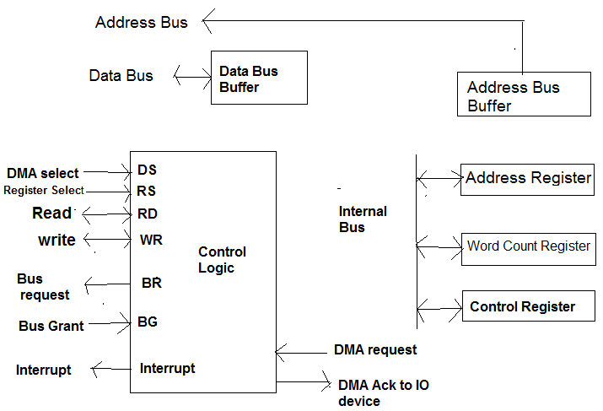
DMA Controller
Block diagram of DMA controller is as shown below

Slide 24
The DMA controller has three registers:
Address Register: it contains an address specify the desired location in memory. This register is incremented after each word is transferred.
Word count register: it holds the number of words to be transferred. After each word transfer, it is decremented by 1 and internally tested for zero.
Control register: it specifies the mode of transfer.
DMA controller allows direct data transfer between the device and main memory without involving the processor

Slide 25
It performs the function normally done by processor when accessing main memory.
For each byte or word transfer, it provides necessary memory address & bus signals to control data transfer.
The DMA controller increments the memory address for successive byte or word & keep track of the number of transfers, for transferring block of data.
Although DMA controller can transfer data without interference from processor, its operation must be under the control of program executed by processor.

Slide 26
To initiate the transfer of a block of words, the processor sends the following data to controller:
The starting address,
The number of words in a block
The direction of transfer.
On receiving this information, the DMA controller proceeds to perform requested transfer. When the entire block has been transferred, the controller informs the processor by raising an interrupt signal.

Slide 27
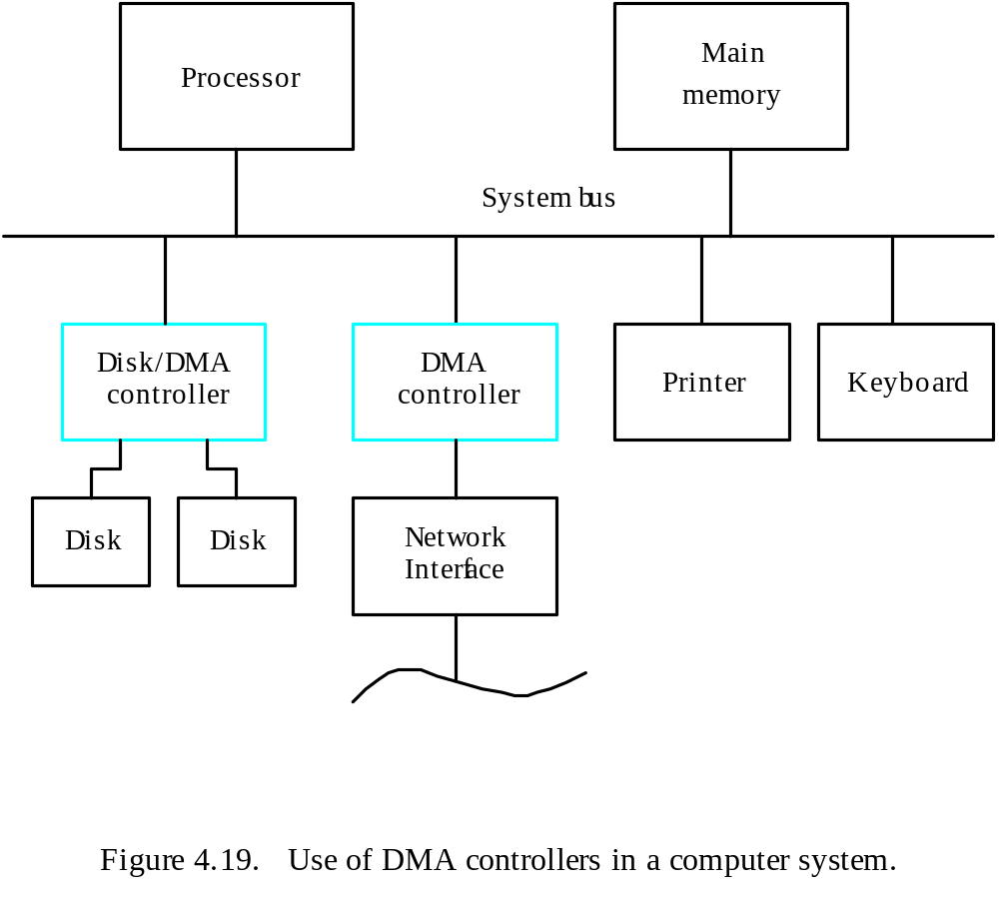
System

Slide 28
Use of DMA Controllers in a computer system.
Main
Processor
memory
System bus
Disk/DMA
DMA
Printer
Keyboard
controller
controller
Disk
Disk
Network
Interface
DMA controller connects a high-speed network to the computer bus.
Disk controller, which controls two disks also has DMA capability. It provides two
DMA channels.
It can perform two independent DMA operations, as if each disk has its own DMA
controller. The registers to store the memory address, word count and status and
control information are duplicated.
Notes:
Let us consider a memory organization with two DMA controllers. In this memory organization, a DMA controller is used to connect a high speed network to the computer bus. In addition, disk controller which also controls two disks may have DMA capability. The disk controller controls two disks and it also has DMA capability. The disk controller provides two DMA channels. The disk controller can two independent DMA operations, as if each disk has its own DMA controller. Each DMA controller has three registers, one to store the memory address, one to store the word count, and the last to store the status and control information. There are two copies of these three registers in order to perform independent DMA operations. That is, these registers are duplicated.

Slide 29
Bus Arbitration
Whenever a device needs to communicate with another device connected to the main board, it must do so with the bus interconnection. Because the bus is shared amongst all the devices.
A method used to determine who(which device) gets access to the bus and when, is referred to a Bus arbitration.
The bus arbitration mechanism is designed so that the high priority device like the processor and RAM get first access to the bus, while other devices like disks, video cards, sound cards etc., get lower priority and often have to wait to access the bus.

Slide 30
Methods of Arbitration:
There are 3 methods of arbitration
Daisy Chaining
Polling
Independent requesting.
1. Daisy Chaining- Here the control of the bus is granted to any module by a Bus Grant signal which is chained through all the contending masters. The two other control signals are Bus Request and Bus Busy.

Slide 31
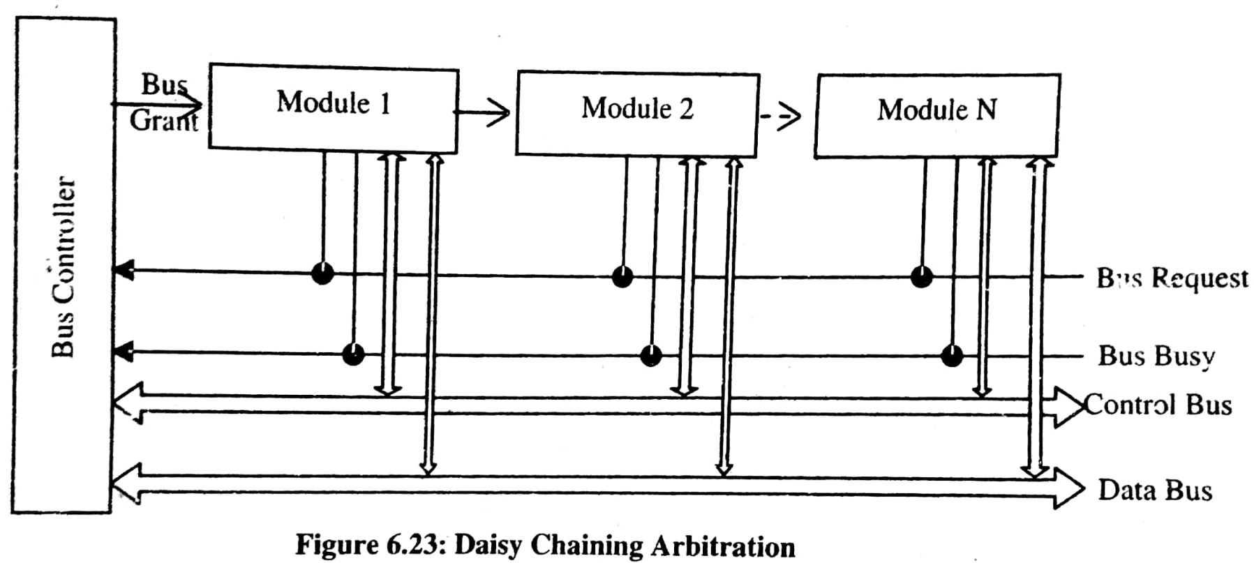

Slide 32
2. Polling: - in polling instead of single Bus Grant line, as in case of daisy chaining, Poll Count lines are encountered. These lines are connected to all the modules connected on the bus.
The Bus Request and Bus Busy are the other two control lines for Bus control.
A request to use the bus is made on the Bus Request line while the Bus Request will not be responded to till the Bus Busy line is active.
The bus controller responds to a signal on Bus Request line by generating a sequence of numbers on poll count lines. These numbers are normally considered to be a unique address assigned to the connected modules.

Slide 33
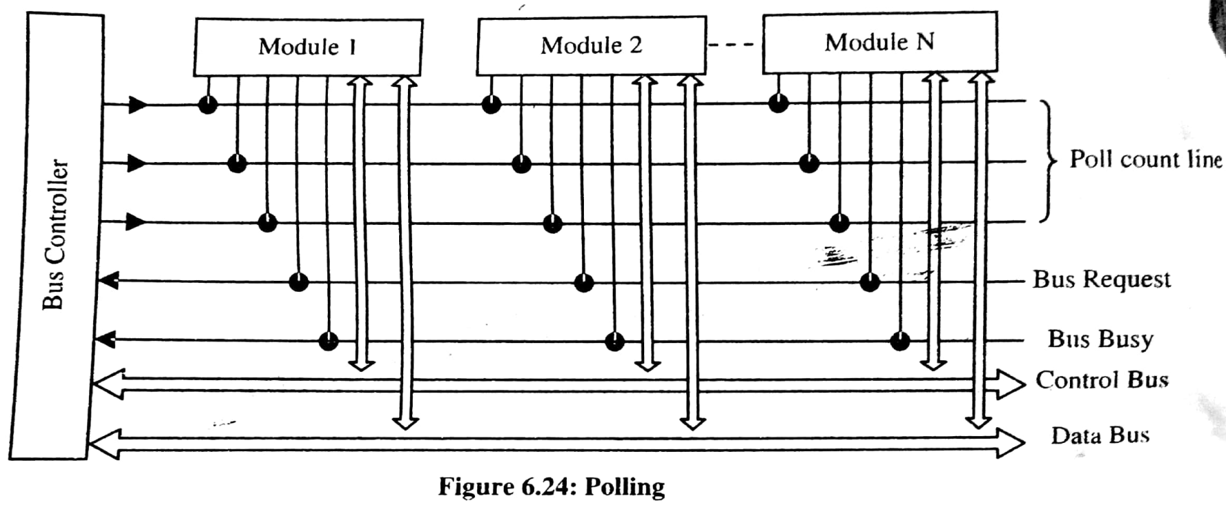
When the poll count matches the address of a particular module that is requesting for the bus, the module activates the Bus Busy signal and starts using the bus.
The polling basically is asking each module one by one whether it has something to do with bus.

Slide 34
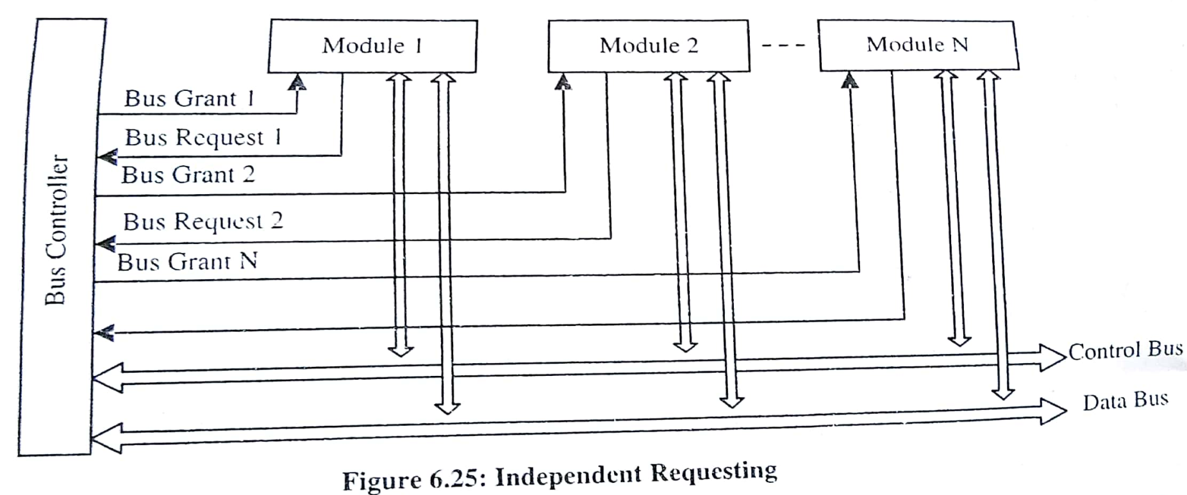
3. Independent Requesting: in this arbitration scheme, each module has an independent Bus Request and Bus Grant line. In this scheme the identification of requesting unit is almost immediate and requests can be responded quickly.
Priority in such system can be built through the bus controller and can be changed through a program (if desired).

Slide 35
Bus arbitration…
Processor and DMA controllers both need to initiate data transfers on the bus and access main memory.
The device that is allowed to initiate transfers on the bus at any given time is called the bus master.
When the current bus master relinquishes its status as the bus master, another device can acquire this status.
  The process by which the next device to become the bus master is selected and bus mastership is transferred to it is called bus arbitration.
1. Centralized arbitration:
  A single bus arbiter performs the arbitration.
2. Distributed arbitration:
  All devices participate in the selection of the next bus master.
Notes:
Processor and DMA controllers both need to initiate data transfers on the bus and access main memory. The process of using the bus to perform a data transfer operation is called as the initiation of a transfer operation. At any point in time only one device is allowed to initiate transfers on the bus. The device that is allowed to initiate transfers on the bus at any given time is called the bus master. When the current bus master releases control of the bus, another device can acquire the status of the bus master. How does one determine which is the next device which will acquire the status of the bus master. Note that there may be several DMA controllers plus the processor which requires access to the bus. The process by which the next device to become the bus master is selected and bus mastership is transferred to it is called bus arbitration. There are two types of bus arbitration processes. Centralized arbitration and distributed arbitration. In case of centralized arbitration, a single bus arbiter performs the arbitration. Whereas in case of distributed arbitration all devices which need to initiate data transfers on the bus participate or are involved in the selection of the next bus master.

Slide 36
1. Centralized Bus Arbitration
B
B
S
Y
B
R
Processor
DMA
DMA
controller
controller
BG1
1
BG2
2

Slide 37
1. Centralized Bus Arbitration(cont.,)
Bus arbiter may be the processor or a separate unit connected to the bus.
Normally, the processor is the bus master, unless it grants bus membership to one of the DMA controllers.
DMA controller requests the control of the bus by asserting the Bus Request (BR) line.
In response, the processor activates the Bus-Grant1 (BG1) line, indicating that the controller may use the bus when it is free.
BG1 signal is connected to all DMA controllers in a daisy chain fashion.
BBSY signal is 0, it indicates that the bus is busy. When BBSY becomes 1, the DMA controller which asserted BR can acquire control of the bus.

Slide 38
2. Distributed arbitration
All devices waiting to use the bus share the responsibility of carrying out the arbitration process.
  Arbitration process does not depend on a central arbiter and hence distributed arbitration has higher reliability.
Each device is assigned a 4-bit ID number.
All the devices are connected using 5 lines, 4 arbitration lines to transmit the ID, and one line for the Start-Arbitration signal.
To request the bus a device:
  Asserts the Start-Arbitration signal.
  Places its 4-bit ID number on the arbitration lines.
The pattern that appears on the arbitration lines is the logical-OR of all the 4-bit device IDs placed on the arbitration lines.

Slide 39
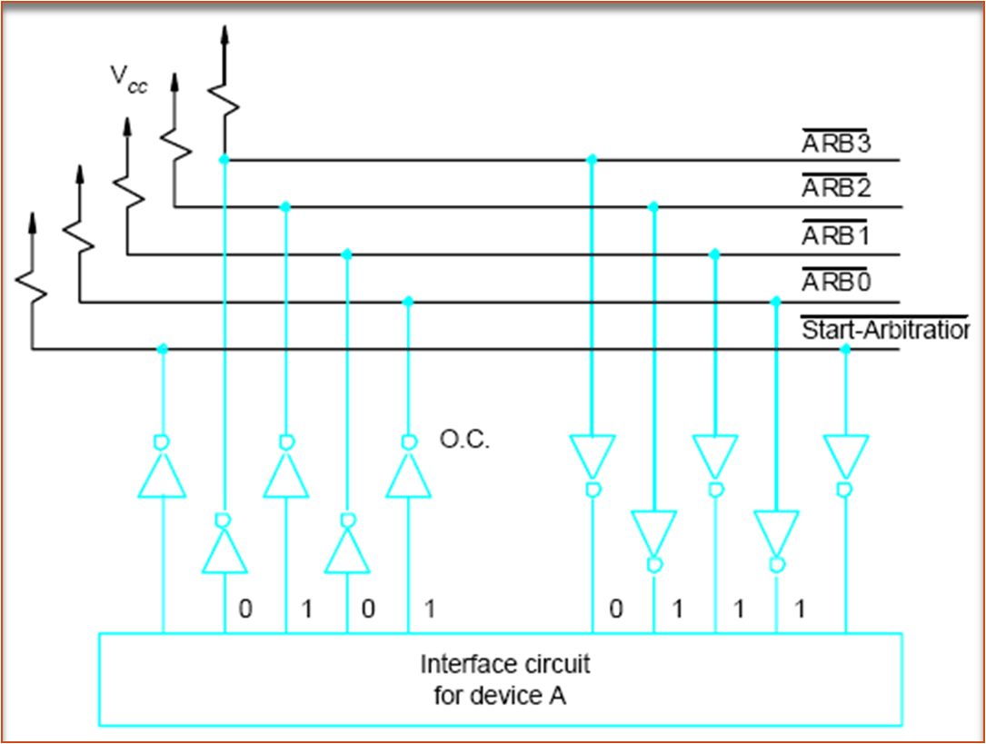
Distributed arbitration

Slide 40
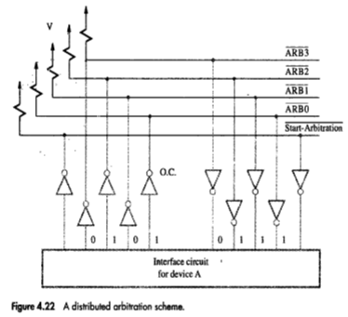

Slide 41
Distributed arbitration(Contd.,)
Arbitration process:
  Each device compares the pattern that appears on the arbitration lines to its own ID, starting with MSB.
  If it detects a difference, it transmits 0s(Zeros) on the arbitration lines for that and all lower bit positions.
  The pattern that appears on the arbitration lines is the logical-OR of all the 4-bit device IDs placed on the arbitration lines.

Slide 42
Summary: Bus Arbitration
The device that is allowed to initiate data transfers on the bus at any given time is called the bus master.
Bus arbitration is the process by which the next device to become the bus master is selected and bus mastership is transferred to it.
Need to establish a priority system.
Two approaches: centralized and distributed

Slide 43
Buses

Slide 44
Buses
Processor, main memory, and I/O devices are interconnected by means of a bus.
Bus provides a communication path for the transfer of data.
  Bus also includes lines to support interrupts and arbitration.
A bus protocol is the set of rules that govern the behavior of various devices connected to the bus.
It must also look in to,
when to place information on the bus?
when to assert control signals ?

Slide 45
Buses (contd..)
Bus lines may be grouped into three types:
  Data
  Address
  Control
Control signals specify:
  Whether it is a read or a write operation.
  Required size of the data, when several operand sizes (byte, word, long word) are possible.
  Timing information to indicate when the processor and I/O devices may place data or receive data from the bus.
Schemes for timing of data transfers over a bus can be classified into:
  Synchronous,
  Asynchronous.
Notes:
Recall that one device plays the role of a master. The device that initiates the data transfer on the bus by issuing read or write control signals is called as a master. The device that is being addressed by the master is called a slave or a target.

Slide 46
Synchronous & Asynchronous schemes
Bus master is an initiator. Usually, processor acts as master. But under DMA setup, any other device can be master.
The device addressed by the master is slave or target.

Slide 47
Synchronous bus
All devices derive timing information from a common clock line.
Equally spaced pulses on this line define equal time intervals.
Each of these intervals constitutes a bus cycle during which one data transfer can take place.
Timing of an input/output transfer on a synchronous bus is shown in figure.

Slide 48
Timing of an input transfer on a synchronous Bus
T
ime
Bus clock
Address and
command
Data
t
0
t
1
t
2
Master places the
device address and
command on the bus,
and indicates that
it is a Read operation.
Bus cycle
Addressed slave places
data on the data lines
Master “strobes” the data
on the data lines into its
input buffer, for a Read
operation.
In case of a Write operation, the master places the data on the bus along with the
address and commands at time t₀.
The slave strobes the data into its input buffer at time t₂.

Slide 49
Synchronous bus (contd..)
Once the master places the device address and command on the bus, it takes time for this information to propagate to the devices:
  This time depends on the physical and electrical characteristics of the bus.
Also, all the devices have to be given enough time to decode the address and control signals, so that the addressed slave can place data on the bus.
Width of the pulse t₁ - t₀ depends on:
  Maximum propagation delay between two devices connected to the bus.
  Time taken by all the devices to decode the address and control signals, so that the addressed slave can respond at time t₁.

Slide 50
Synchronous bus (contd..)
At the end of the clock cycle, at time t₂, the master strobes the data on the data lines into its input buffer if it’s a Read operation.
  “Strobe” means to capture the values of the data and store them into a buffer.
When data are to be loaded into a storage buffer register, the data should be available for a period longer than the setup time of the device.
Width of the pulse t₂ - t₁ should be longer than:
  Maximum propagation time of the bus plus
  Set up time of the input buffer register of the master.

Slide 51
A detailed Timing diagram
T
ime
Address &
command
appear on the
bus.
Bus clock
Data reaches
the master.
Seen by
master
t
AM
Address and
command
Address &
command reach
the slave.
Data
t
DM
Seen by slave
t
AS
Data appears
on the bus.
Address and
command
Data
t
DS
t
t
1
t
0
2
Signals do not appear on the bus as soon as they are placed on the bus, due to the
propagation delay in the interface circuits.
Signals reach the devices after a propagation delay which depends on the
characteristics of the bus.
Data must remain on the bus for some time after t₂ equal to the hold time of the buffer.
Notes:
t_{AM,} tDM Address Master, Data Master
t_{AS,} t_{DS}

Slide 52
Synchronous bus (contd..)
Most buses have control signals to represent a response from the slave.
Control signals serve two purposes:
  Inform the master that the slave has recognized the address, and is ready to participate in a data transfer operation.
  Enable to adjust the duration of the data transfer operation based on the speed of the participating slaves.
High-frequency bus clock is used:
  Data transfer spans several clock cycles instead of just one clock cycle as in the earlier case.

Slide 53
An input transfer using multiple clock cycles
Address & command
requesting a Read
operation appear on
the bus.
T
ime
1
2
3
4
Clock
Address
Command
Master strobes data
into the input buffer.
Data
Sla
v
e-ready
Slave places the data on the bus,
and asserts Slave-ready signal.
Clock changes are seen by all the devices
at the same time.
Notes:
Slave-ready signal is an acknowledgement from the slave to the master to confirm that the valid data has been sent. Depending on when the slave-ready signal is asserted, the duration of the data transfer can change.

Slide 54
Asynchronous Bus
An alternative scheme for controlling data transfers on a bus is based on the use of a handshake protocol between the master and the slave.
A handshake is an exchange of command and response signals between the master and the slave.
It is a generalization of the way the Slave-ready signal is used in synchronous bus.
A control line called Master-ready is asserted by the master to indicate that it is ready to start a data transfer.
The slave responds by asserting Slave-ready.

Slide 55
A data transfer controlled by a handshake protocol proceeds as follows.
The master places the address and command information on the bus. Then it indicates to all devices that it has done so by activating the Master-ready line. This causes all devices to decode the address.
The selected slave performs the required operation and informs the processor that it has done so by activating the slave-ready line.
The master waits for slave-ready to become asserted before it removes its signals from the bus .

Slide 56
Asynchronous bus
Data transfers on the bus is controlled by a handshake between the master and the slave.
Common clock in the synchronous bus case is replaced by two timing control lines:
  Master-ready,
  Slave-ready.
Master-ready signal is asserted by the master to indicate to the slave that it is ready to participate in a data transfer.
Slave-ready signal is asserted by the slave in response to the master-ready from the master, and it indicates to the master that the slave is ready to participate in a data transfer.

Slide 57
Asynchronous bus (contd..)
Data transfer using the handshake protocol:
  Master places the address and command information on the bus.
  Asserts the Master-ready signal to indicate to the slaves that the address and command information has been placed on the bus.
  All devices on the bus decode the address.
  Address slave performs the required operation, and informs the processor it has done so by asserting the Slave-ready signal.
  Master removes all the signals from the bus, once Slave-ready is asserted.
  If the operation is a Read operation, Master also strobes the data into its input buffer.
The following fig is Handshake control of data transfer during on input operation.

Slide 58
Handshake control of data transfer during an input operation
T
ime
Address
and command
Master-ready
Slave-ready
Data
t
0
t
1
t
2
t
3
t
4
t
5
Bus cycle
t₀ - Master places the address and command information on the bus.
t₁ - Master asserts the Master-ready signal. Master-ready signal is asserted at t₁ instead of t₀
t₂ - Addressed slave places the data on the bus and asserts the Slave-ready signal.
t₃ - Slave-ready signal arrives at the master.
t₄ - Master removes the address and command information.
t₅ - Slave receives the transition of the Master-ready signal from 1 to 0. It removes the data and the Slave-ready signal from the bus.

Slide 59
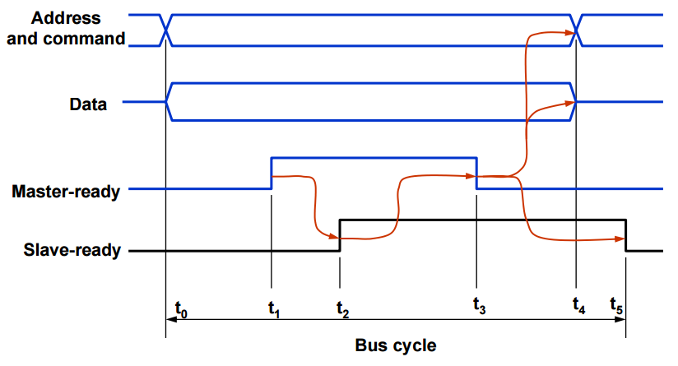
Handshake control of data transfer during an output operation

Slide 60
Asynchronous vs. Synchronous bus
Synchronous Bus:
Include a clock in the control lines.
A fixed protocol for communication that is relative to the clock.
Advantage: involves very little logic and can run very fast.
Disadvantages: every device on the bus must run at the same clock rate.
To avoid clock skew, they cannot be long if they are fast.

Slide 61
Synchronous Vs Asynchronous bus
Asynchronous Bus:
It is not clocked
It can accommodate a wide range of devices
It can be lengthened without worring about clock skew.
It requires a handshaking protocol.
Advantages of asynchronous bus:
  Eliminates the need for synchronization between the sender and the receiver.
  Can accommodate varying delays automatically, using the Slave-ready signal.
Disadvantages of asynchronous bus:
  Data transfer rate with full handshake is limited by two-round trip delays.
  Data transfers using a synchronous bus involves only one round trip delay, and hence a synchronous bus can achieve faster rates.

Slide 62
Synchronous Bus Vs Asynchronous Bus
Synchronous Bus:
  Control and data signals move with respect to a common clock (usually one of the bus control lines).
  - Advantage: low latency & high bandwidth.
  Disadvantages:
  - Every device on the bus must run at the same clock rate
  - To avoid clock skew, bus cannot be long if it is fast.
Asynchronous Bus:
  - It is not clocked.
  - It can accommodate a wide range of devices.
  - It can be lengthened without worrying about clock skew.
  - Communication protocol is more complicated.
DEPT. OF MCA PESIT

Slide 63
Interface Circuits

Slide 64
Interface Circuits
An I/O interface consists of the circuitry required to connect an I/O device to a computer bus.
On one side of the interface, we have bus signals. On the other side, we have a data path with its associated controls to transfer data between the interface and the I/O device – port. We have two types:
Serial Port
Parallel Port

Slide 65
A parallel port transfers data in the form of a number of bits (8 or 16) simultaneously to or from the device.
  A serial port transmits and receives data one bit at a time.
  Communication with the bus is the same for both formats. The conversion from the parallel to the serial format, and vice versa, takes place inside the interface circuit.
In parallel port, the connection between the device and the computer uses a multiple-pin connector and a cable with as many wires. This arrangement is suitable for devices that are physically close to the computer.
  In serial port, it is much more convenient and cost-effective where longer cables are needed.

Slide 66
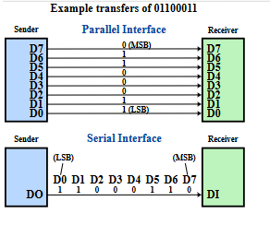

Slide 67
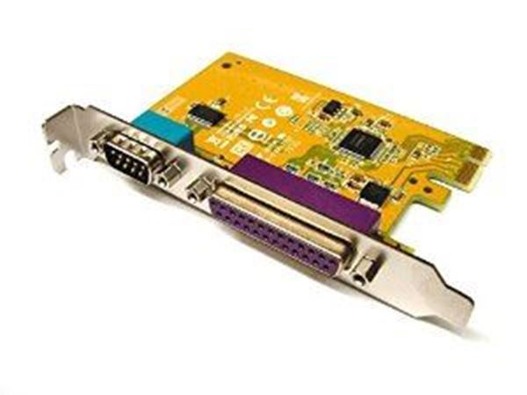
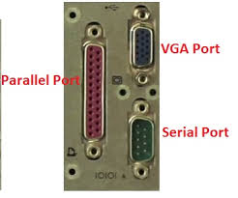
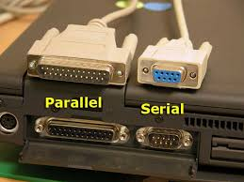

Slide 68
Functions of I/O interface
Typically, the functions of an I/O interface are:
  Provides a storage buffer for at least one word of data
  Contains status flags that can be accessed by the processor to determine whether the buffer is full or empty
  Contains address-decoding circuitry to determine when it is being addressed by the processor
  Generates the appropriate timing signals required by the bus control scheme
  Performs any format conversion that may be necessary to transfer data between the bus and the I/O device, such as parallel-serial conversion in the case of a serial port

Slide 69
Keyboard to processor connection
The hardware components needed for connecting a keyboard to a processor: Consider the circuit of input interface which encompasses
  Status flag, SIN
  R/~W
  Master-ready
  Address decoder
A detailed figure showing the input interface circuit is presented in figure 4.29. Now, consider the circuit for the status flag .An edge-triggered D flip-flop is used along with read-data and master-ready signals.

Slide 70
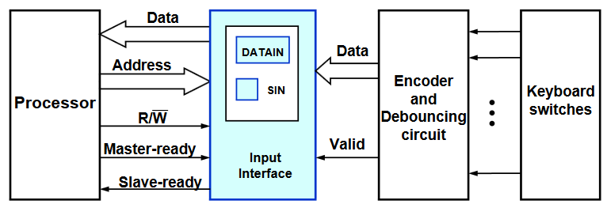
Interface Circuits…
Keyboard to processor connection
When a key is pressed, the Valid signal changes from 0 or 1, causing the ASCII code to be loaded into DATAIN and SIN to be set to 1
The status flag SIN is cleared to 0 when the processor reads the contents of the DATAIN register

Slide 71
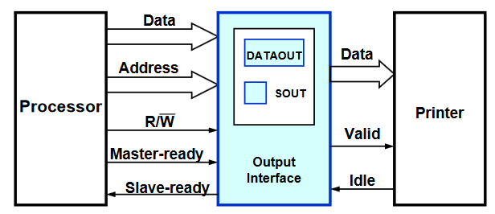
Printer to Processor Connection
The interface contains a data register, DATAOUT, and a status flag, SOUT.‹
The SOUT flag is set to 1 when the printer is ready to accept another character, and it is cleared to 0 when a new character is loaded into DATAOUT by the processor. ‹
When the printer is ready to accept a character, it asserts its idle signal

Slide 72
Serial Port
A serial port is used to connect the processor to I/O devices that require transmission of data one bit at a time
The key feature of an interface circuit for a serial port is that it is capable of communicating in a bit-serial fashion on the device side and in a bit-parallel fashion on the bus side
The transformation between the parallel and serial formats is achieved with shift registers that have parallel access capability

Slide 73
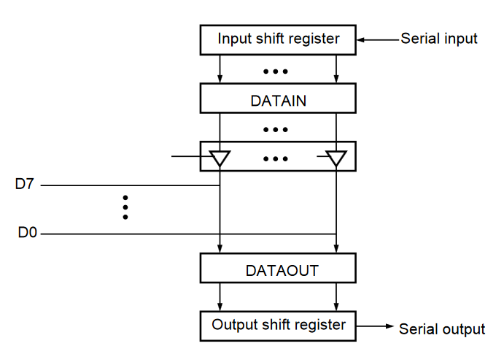
A serial interface

Slide 74
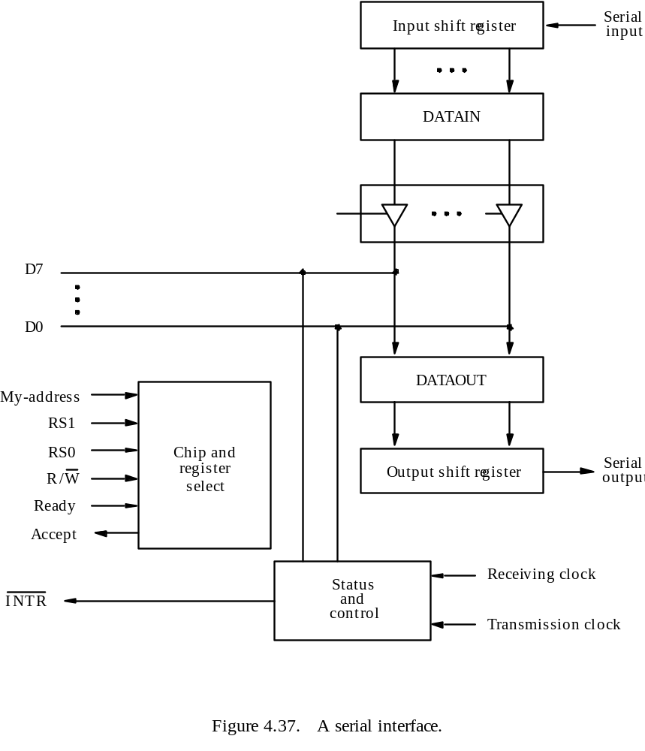

Slide 75
Parallel Port
A parallel port transfers data in the form of a number of bits, typically 8 or 16, simultaneously to or from the device.
For faster communications

Slide 76
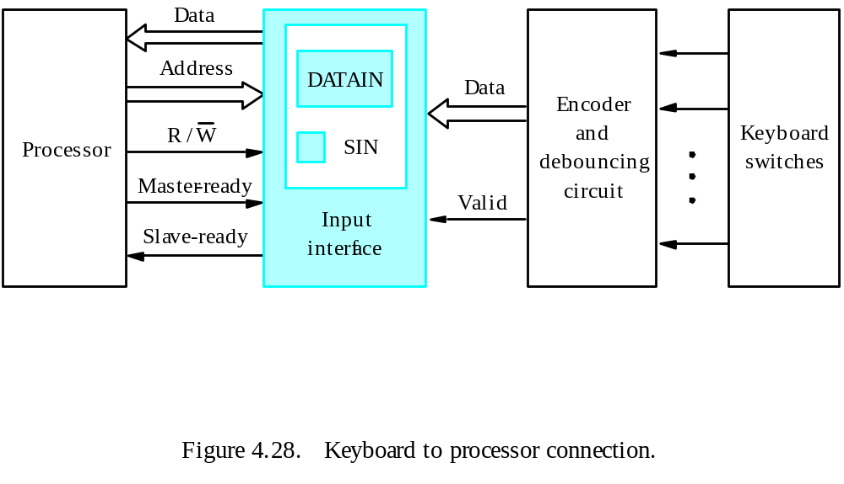
Parallel Port – Input Interface (Keyboard to Processor Connection)

Slide 77
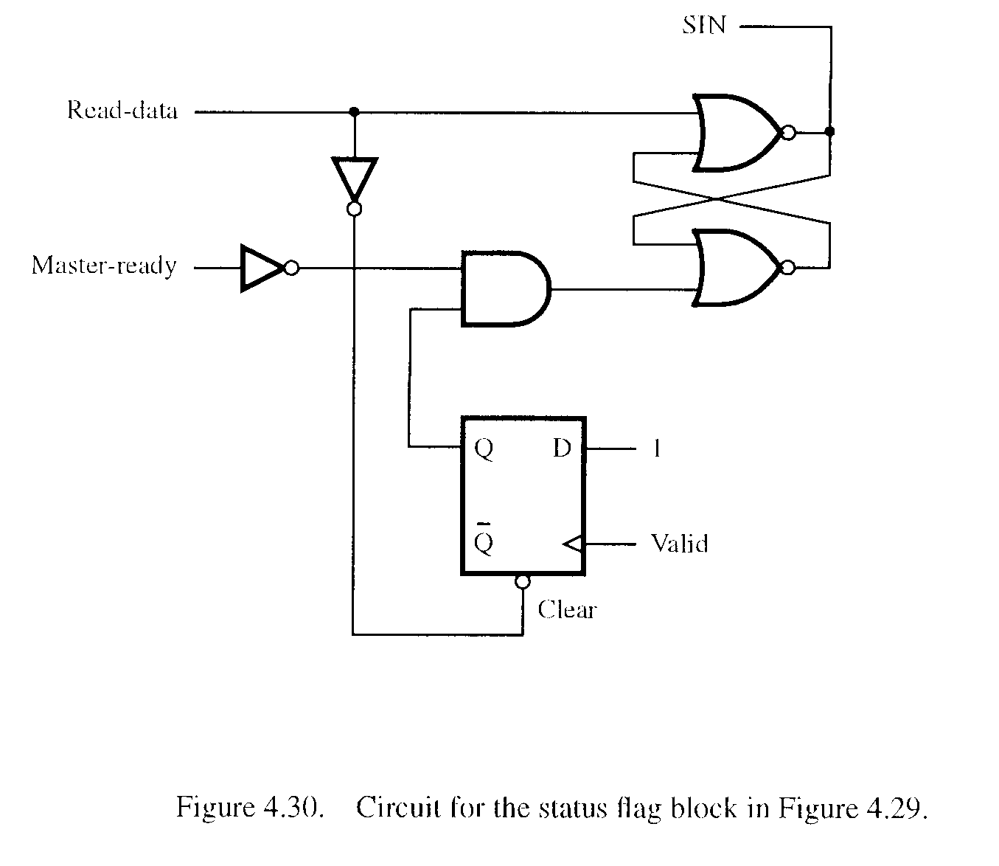
Parallel Port – Input Interface (Keyboard to Processor Connection)

Slide 78
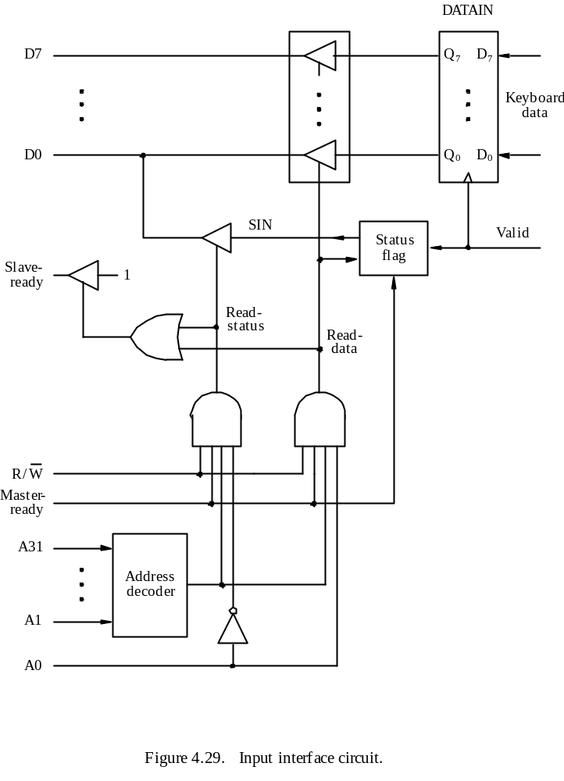

Slide 79
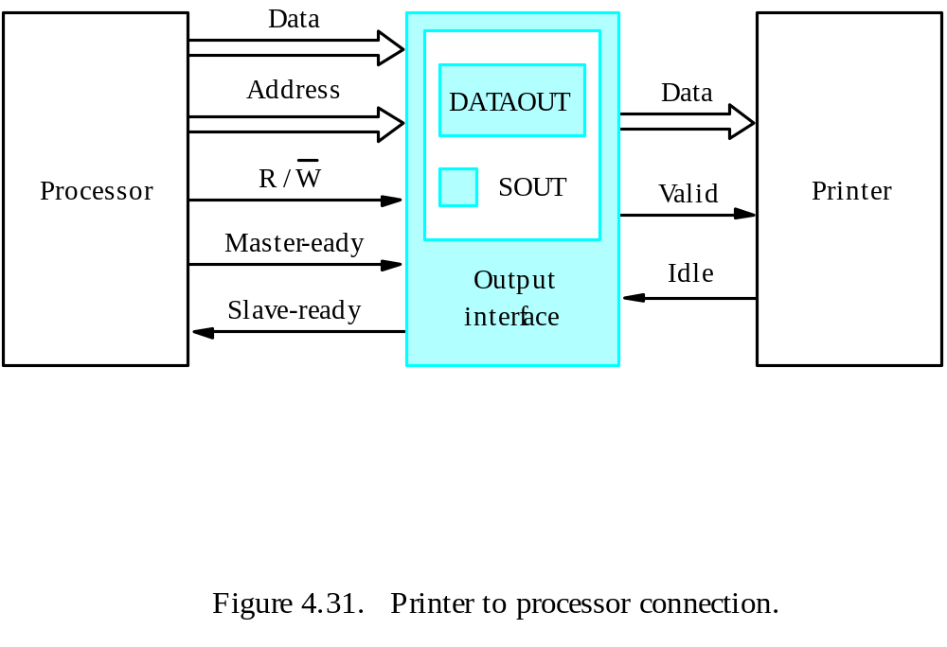
Parallel Port – Output Interface (Printer to Processor Connection)

Slide 80
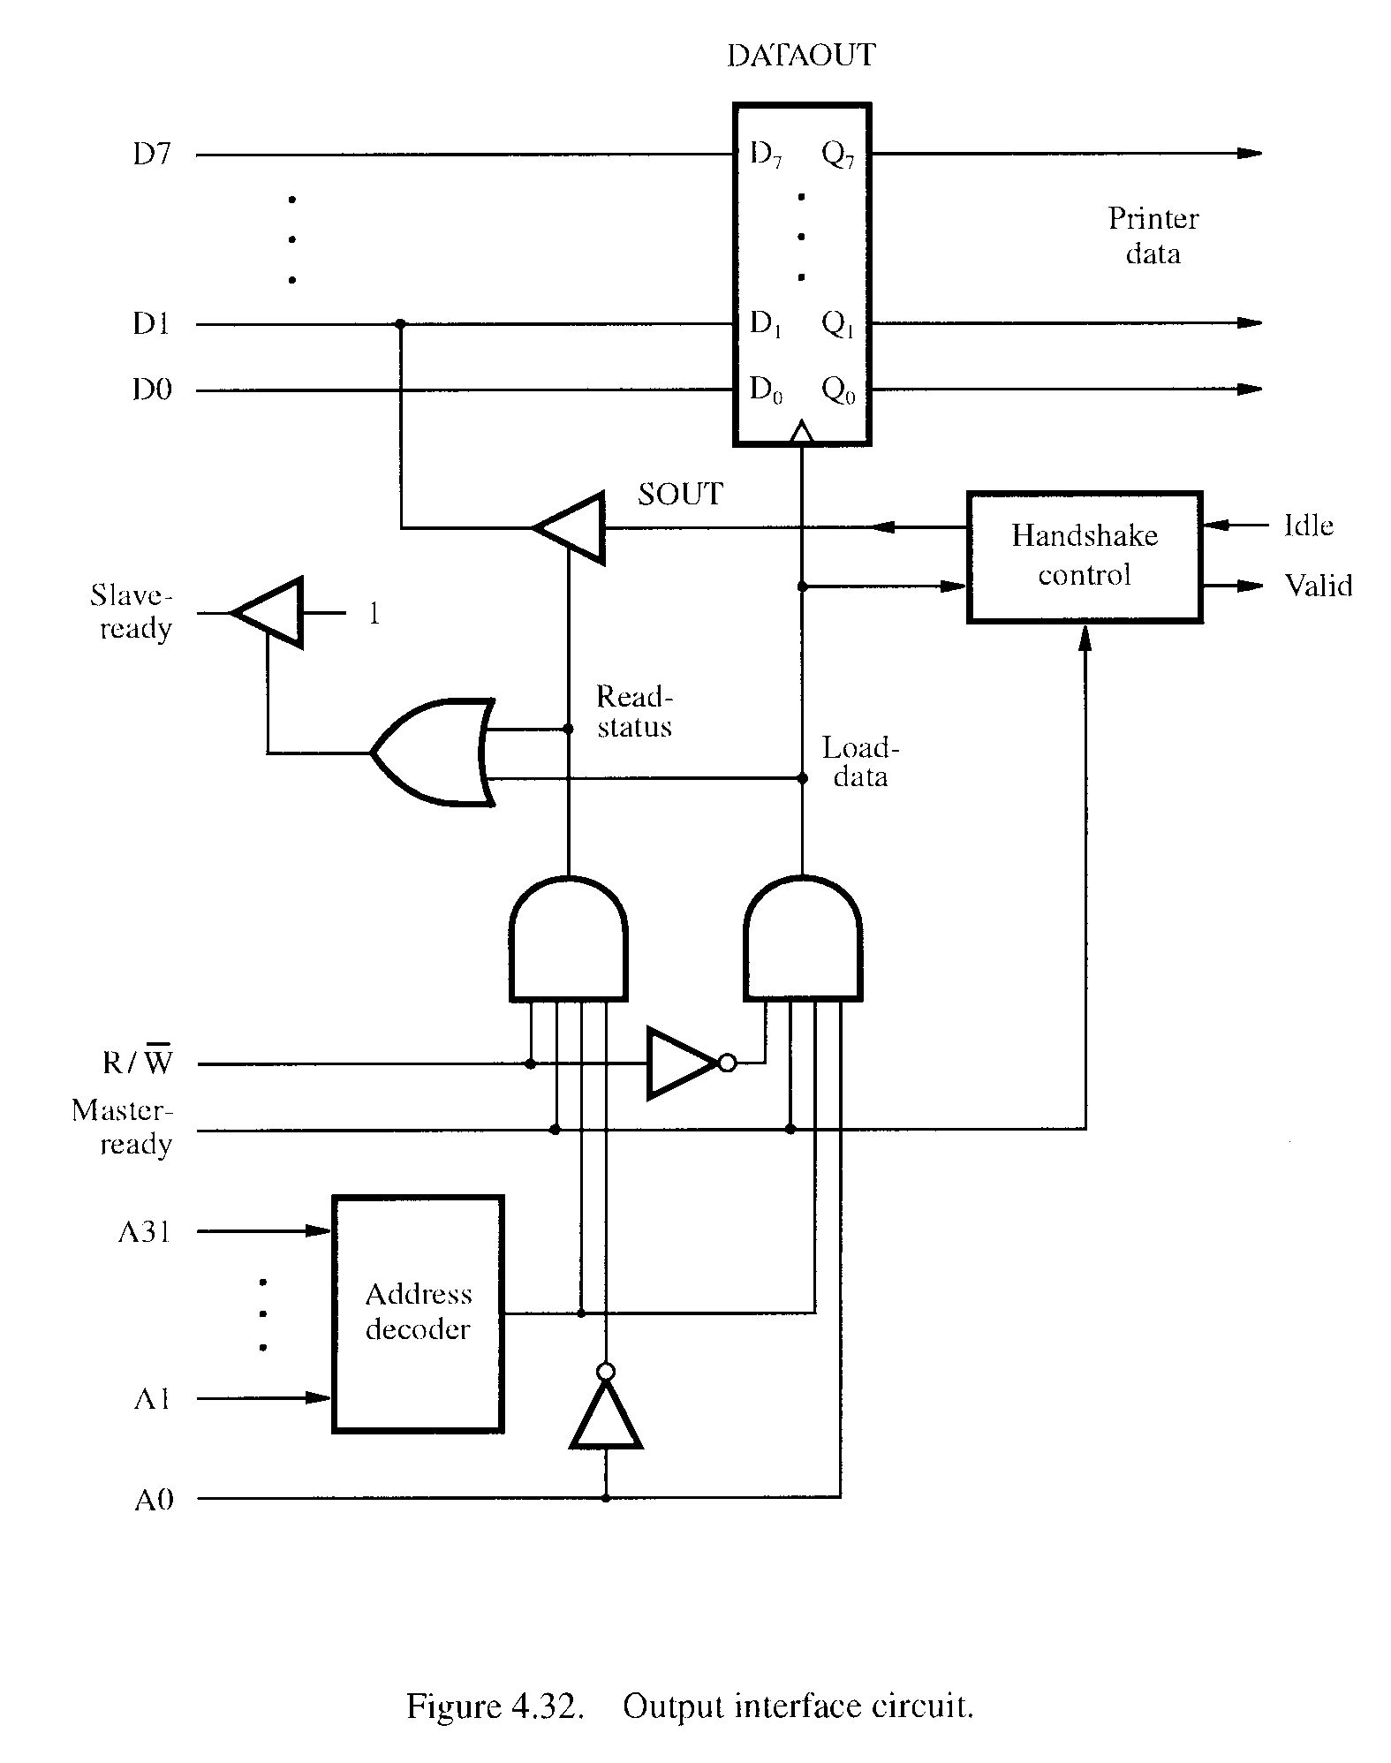

Slide 81
D7
Bus
P
A7
D
A
T
AIN
D1
D0
P
A0
SIN
Input
CA
status
PB7
D
A
T
A
OUT
PB0
SOUT
Handshak
e
CB1
control
CB2
Sla
v
e-
1
Ready
Master
-
Ready
R
/
W
A31
Address
My-address
decoder
A2
A1
RS1
A0
RS0
Figure 4.33. Combined input/output interface circuit.

Slide 82
End of Unit 4

